Slide 1
PV Access
July 2026
Kay Kasemir

Slide 2
EPICS Network Protocols
Channel Access
  Since beginning of EPICS
  DBR_*: Number, enum, string, scalar or array, with time, alarm, limits
  Still fully supported with bug fixes
PV Access
  Started as “EPICS V4”,
  since EPICS 7 (2017) in base
  PV Data: Arbitrary structures
  New features being added

Slide 3
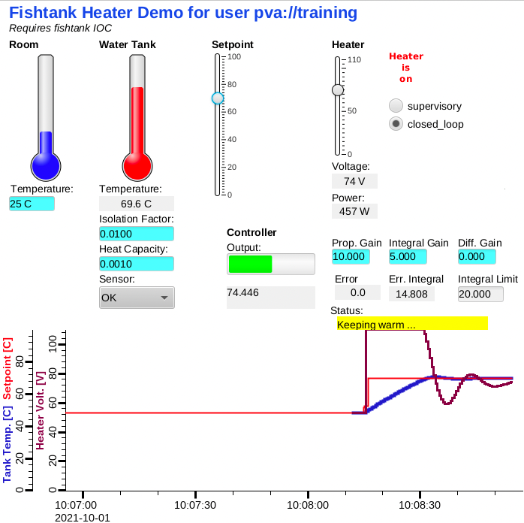
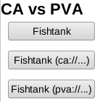
First Glance
softIocPVA instead of softIoc
  # We did this before:
  cd /ics/examples/fishtank
  cat st.cmd
  # Compare, then run:
  cd /ics/examples/15_pvaccess
  cat st.cmd
  ./st.cmd
pv… instead of ca…
  camonitor epics-dev:setpoint epics-dev:tank
  pvmonitor epics-dev:setpoint epics-dev:tank
  pvput epics-dev:setpoint 40
  caput epics-dev:setpoint 30
CS-Stud﻿io:
  css -resource /ics/examples/15_pvaccess/pva.bob

Slide 4
PV Access
Like Channel Access
  Name search via UDP
  Connection for data transfer via TCP
  EPICS_PVA_ADDR_LIST, EPICS_PVA_AUTO_ADDR_LIST
Get, put, monitor
  Plus an ‘RPC’ type operation
Arbitrary PV Data structures instead of DBR_.. types

Slide 5
Custom Data: Great, but then what?
Keith’s structure:
short level
double data
string type
time stamp
…
Jürgen’s structure:
short grad
double wert
string typ
long zeit
…
Fred’s structure:
double value
short status
short severity
string units
time timeStamp
…
Which number to show on a user display?
What units?
Is this an alarm?
Time stamp?
Jane’s structure:
short info
double content
string meta
long ms
…

Slide 6
“Normative Types”
Channel Access
struct dbr_ctrl_double:
short status
short severity
short precision
char units[8]
… no timestamp …
double value
struct dbr_time_double:
short status
short severity
timestamp stamp
double value
You get what you request
(network always transfers complete struct)
PV Access
epics:nt/NTScalar:
double value
int alarm/status
int alarm/severity
string display/units
int display/precision
time timeStamp
…
You get what you request
(but network only transfers changes)

Slide 7
Channel Access vs. PV Access
Similar command line tools:
caget epics-dev:tank
camonitor epics-dev:tank
cainfo epics-dev:tank
caget –d CTRL_DOUBLE epics-dev:tank
# Not supported
camonitor –d CTRL_DOUBLE epics-dev:tank
caget epics-dev:tank.SCAN
pvget epics-dev:tank
pvmonitor epics-dev:tank
pvinfo epics-dev:tank
pvget –M raw epics-dev:tank
# Note first few updates!
pvmonitor –M raw epics-dev:tank
pvget epics-dev:tank.SCAN
… and pvxget, pvxinfo, …

Slide 8
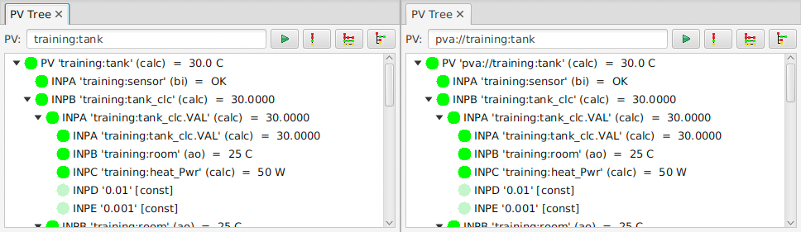

CS-Studio
Use pva://… prefix to select PV Access
Use ca://… prefix to select Channel Access
Set default in ﻿/ics/tools/css_training.ini

Slide 9
So it’s very similar, maybe more efficient…
What’s really new?
How about those custom structures?

Slide 10
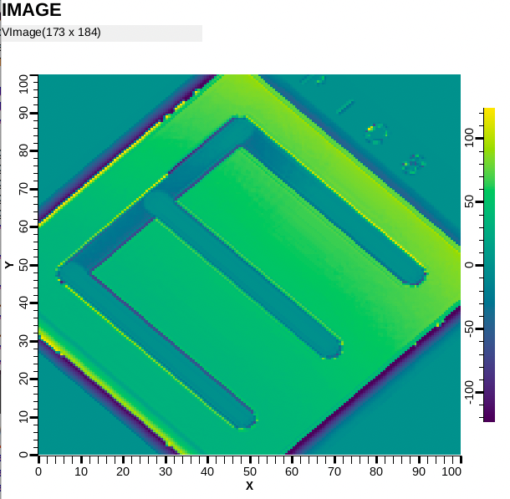
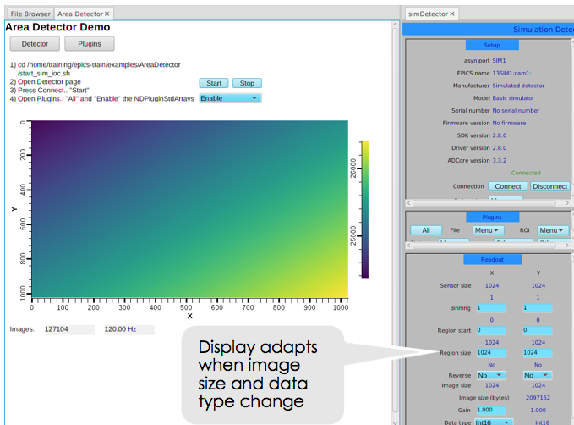
Images: Normative type NTNDArray
See Area Detector (NDPluginPVA) or
cd /ics/examples/15_pv_access
./start_imagedemo
Terminal
pvinfo IMAGE
CS-Studio: Image widget
  Only needs pva://IMAGE
  See
  examples/15_pvaccess/
  PVA_IMAGE.bob

Slide 11

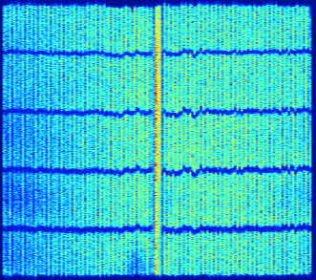

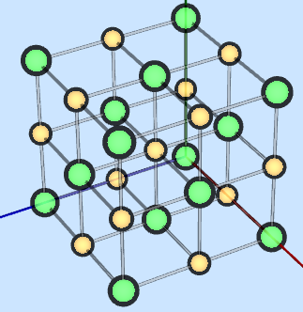
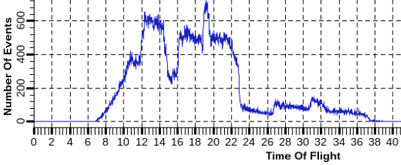
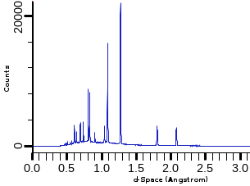
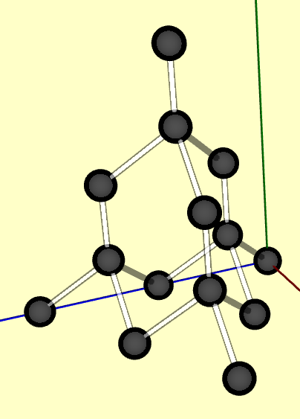
SNS Neutron Data
1) Where was the detector hit?
Detector
scattered neutron
neutron
Sample
2) When was the detector hit?
.. relative to start of cycle: 60 Hz, 30 Hz, …
“Time of Flight” → Speed of neutron → Wavelength
3) Where & wavelength?
→ Distance of scattering centers → Model of sample structure
NaCl?
Diamond?

Slide 12
Custom PV Data
Detector
SNS Beam Lines started to use this in ~2014
  cd /ics/examples/15_pvaccess
  ./start_neutrondemo
  pvinfo neutrons
  pvmonitor neutrons
Allows fetching just what’s needed:
  # For detector pixel display
  pvget -r 'field(pixel)' neutrons
  # For time of flight display
  pvmonitor -r 'field(timeStamp, pixel)' neutrons
  # For d-space displays
  pvmonitor -r 'field(time_of_flight, pixel)' neutrons
PVA neutron data
Processing IOC

Slide 13
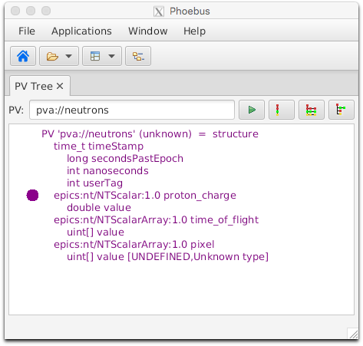
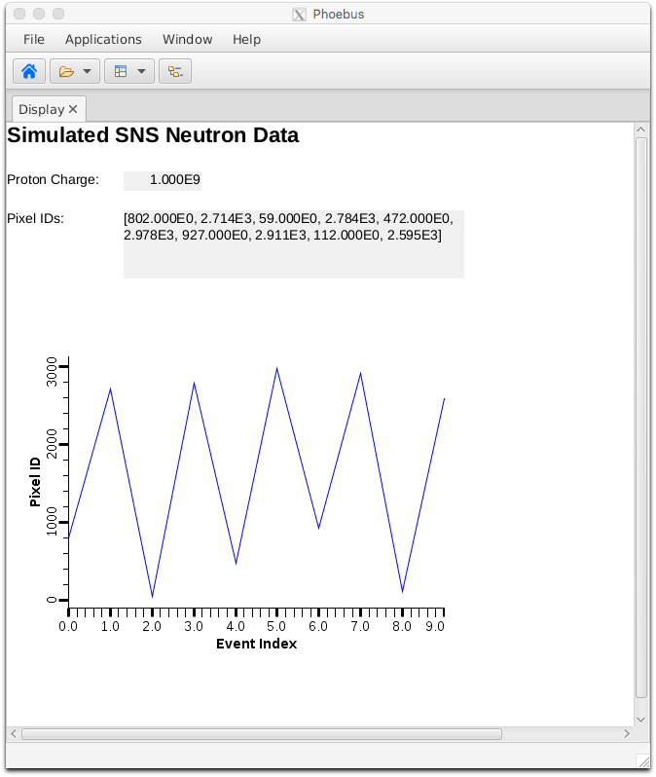
Custom PV Data in CS-Studio
Cannot handle arbitrary structure
  pva://neutrons
Can handle fields which are
scalar or array
  pva://neutrons/proton_charge
  pva://neutrons/pixel

Slide 14
PV Access and Python
Basic ‘get’, ‘put’, ‘monitor’
PV Access server for normative types or custom data
  See *.py examples under
  cd /ics/examples/15_pvaccess

Slide 15
Custom PV Data from IOC Records
`makeBaseApp.pl –t example` includes “group”:
rm –rf /ics/examples/mine
mkdir –p /ics/examples/mine
cd /ics/examples/mine
makeBaseApp.pl -t example demo
makeBaseApp.pl -t example -i demo
# When prompted, use the previously created ‘demo’
make
cd iocBoot/iocdemo
chmod +x st.cmd
./st.cmd
Check demoApp/Db/circle.db
  Calc records ..:circle:x & ..:circle:y compute (x, y) coordinate on circle
  info() annotations create PV ”epics-dev:circle” PV as struct { angle, x, y }
PVA “epics-dev:circle” updates atomically
  camonitor epics-dev:circle:x epics-dev:circle:y receives separate x, y updates
  pvmonitor epics-dev:circle will always see sqrt(x²+y²)==1
  cd /ics/examples/15_pvaccess
  python circle.py

Slide 16
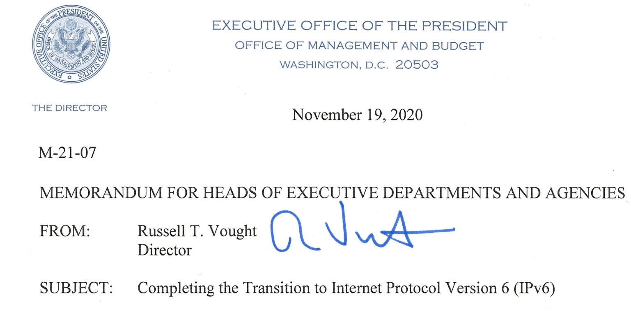
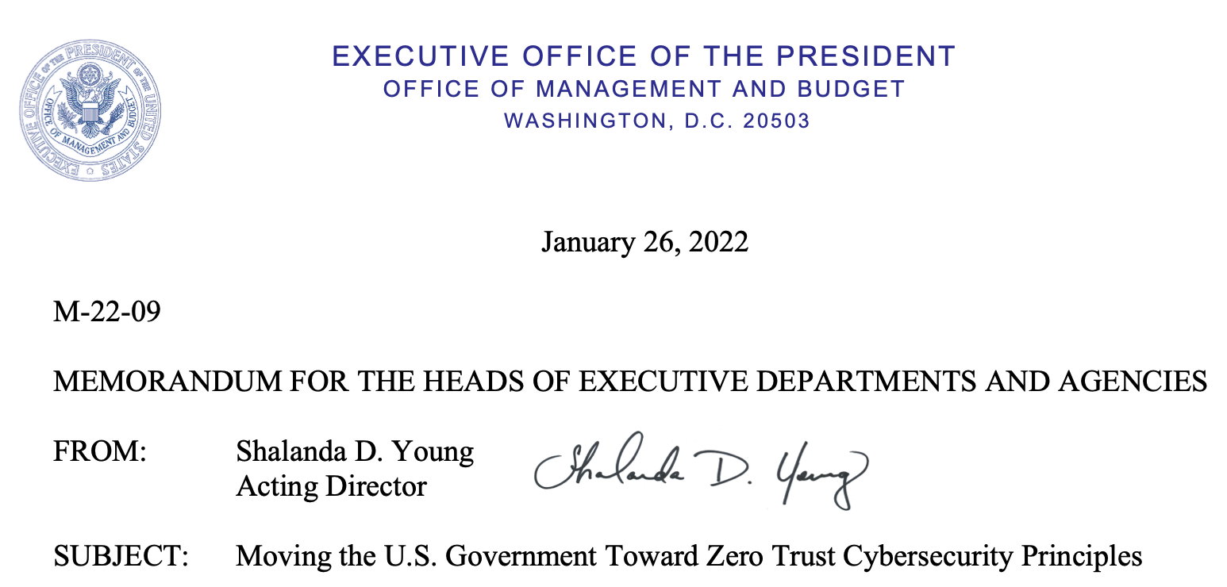
State of PV Access in June 2026
Done, operational
PVA server for records in IOC
CS-Studio client
Area Detector images
Custom data servers and clients
  SNS: neutron data
  APS: services
Gateway
Ongoing
How to best combine data from records into custom PVA data?
Syntax for PVA links between IOC.
Need global “use PVA” option
Support for IPv6
  Implemented,
  no operational experience
Network Security
  Can replace TCP with ‘TLS’
  Ongoing work related to certificate management

Slide 17
History
Channel Access
PV Access
libca
C, later C++ client
rsrv (in IOC)
C
server for records
pvAccessCPP
C++
server and client
pvAccessJava
Java
server and client
pcas
C++
“portable” server
qsrv
C++
server for records
core.pva
Java
client (and server)
jca
Java wrapper for client
Time (not to scale)
PVXS
C++
server and client
caj
Pure Java client
pyaPy
Python wrapper
IPv6, TLS, …
qsrv2
C++
server for records
pyepics
Python wrapper for client
PCASpy
Python wrapper for server
p4p
Python wrapper

Slide 18
Summary: PV Access is ..
Update to Channel Access
  Both can be used in parallel
Similar, but supports custom data types
  Won’t replace IOC/records/normative types,
  but useful for special cases
Since EPICS 7 included in base IOC
  Details of ‘group’, ‘field(…)’ access still evolving
  IPv6 and network security will require PVA!

